Slide 1
Board pack, Q3 2026
BB-Demo, the quarter to 30 Sep 2026
As at Fri 9 Oct 2026

Slide 2
Q3 2026: the quarter
2 new customers and 4 lost in the quarter.
£3.35m
£55,350
100.3%
67
ARR at 30 Sep 2026
Net new ARR in Q3
Net retention, Q3
Customers
Source: B-Brain facts, as at Fri 9 Oct 2026; facts arr_bridge (grain quarterly)

Slide 3
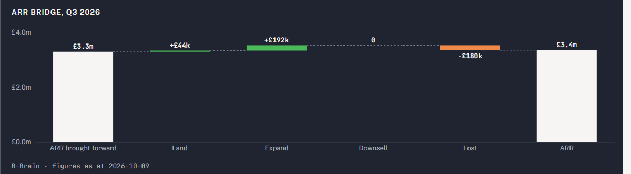
ARR moved £55,350 in the quarter to £3,353,250
ARR brought forward at 30 Jun 2026 to ARR at 30 Sep 2026
Source: B-Brain facts, as at Fri 9 Oct 2026; query chat.arr_bridge (period 3)

Slide 4
The trailing 12 months
84.2%
97.3%
75.6%
-35.8%
ARR growth
Net retention
Gross retention
EBITDA margin
Source: B-Brain facts, as at Fri 9 Oct 2026; facts kpis (12 months to 30 Sep 2026)

Slide 5
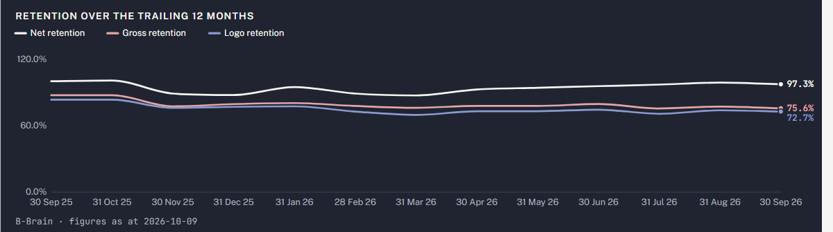
Net retention 97.3%, gross 75.6% over 12 months
Each point is the 12 months to that month end
Source: B-Brain facts, as at Fri 9 Oct 2026; facts arr_bridge (period 12)

Slide 6
16 renewals in 90 days, £697,500 today: these carry more than a price rise
Organisation | Renews | ARR on 9 Oct | At renewal price | Signals besides the price rise
Clonvara Insurance Services | Sun 1 Nov 2026 | £46,800 | £50,000 | champion left, one admin left
Brackwell Freight Ltd | Tue 1 Dec 2026 | £44,000 | £50,000 | users down 30%+, champion left, one admin left, indexing flat, CRM duplicate
Dunholm Precision | Tue 1 Dec 2026 | £51,000 | £50,000 | champion left, one admin left, CRM duplicate
Carnmoor Fleet Leasing | Wed 2 Dec 2026 | £41,800 | £50,000 | users down 30%+, indexing flat
Hollins Tarrant | Mon 4 Jan 2027 | £19,500 | £22,000 | users down 30%+, indexing flat
Veldmaat Payments | Tue 5 Jan 2027 | £45,000 | £50,000 | overdue invoice, disputed invoice
Source: B-Brain facts, as at Fri 9 Oct 2026; facts renewals_due

Slide 7
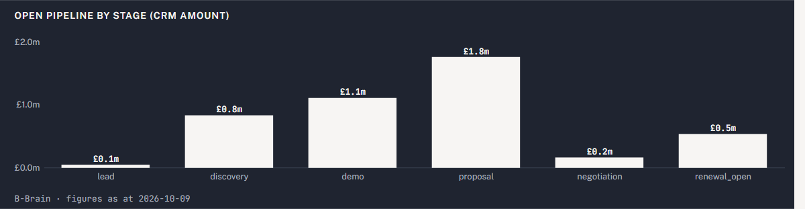
63 open deals carrying £4,456,750 of CRM amount
The CRM's own amounts on open deals, by stage
Source: B-Brain facts, as at Fri 9 Oct 2026; facts pipeline

Slide 8
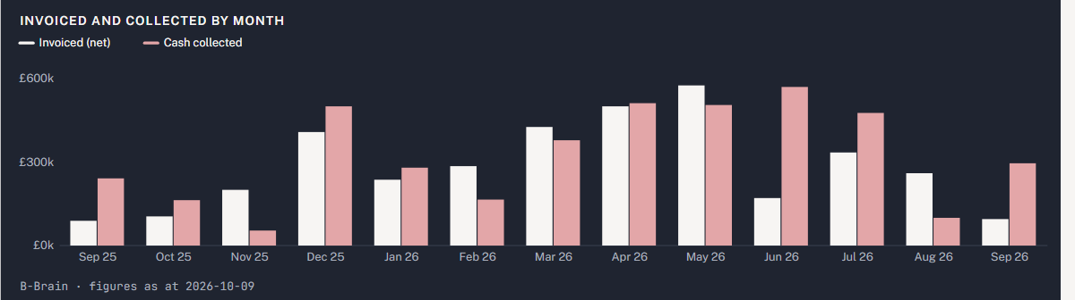
Cash: invoiced and collected
Invoices by issue month, cash by payment month
Source: B-Brain facts, as at Fri 9 Oct 2026; facts billing_monthly

Slide 9
Debtors: £251,936 open, £12,500 overdue
Organisation | Invoice | Due | Bucket | Status | Amount
Veldmaat Payments | INV-003-0004 | Wed 5 Aug 2026 | 61-90 | disputed | £12,500
Veldmaat Payments | INV-003-0005 | Wed 4 Nov 2026 | not yet due | open | £12,500
Ardcarne Life Assurance | INV-008-0002 | Sat 31 Oct 2026 | not yet due | open | £125,000
Hollowmere Care Group | INV-023-0004 | Sat 31 Oct 2026 | not yet due | open | £36,150
Brakkevoort Logistics | INV-024-0008 | Sat 31 Oct 2026 | not yet due | open | £11,000
Pemaquid Analytics | INV-087-0003 | Fri 30 Oct 2026 | not yet due | open | £4,011
Fulford Ings Software | INV-173-0003 | Thu 5 Nov 2026 | not yet due | open | £26,400
Oosterdijk Logistiek | INV-176-0005 | Thu 29 Oct 2026 | not yet due | open | £12,500
Kronfeld Assekuranz | INV-177-0004 | Fri 6 Nov 2026 | not yet due | open | £11,875
Source: B-Brain facts, as at Fri 9 Oct 2026; facts debtors, facts debtors_ageing

Slide 10
Key risks
34 organisations carry a hard signal. BB-Demo judges the first six At risk, led by Brackwell Freight Ltd. Renewal price rises and departed champions are the most common threats.
Brackwell Freight Ltd: price rise at the 1 Dec 2026 renewal, falling users, departed champion, one admin, flat indexing.
Dunholm Precision: champion gone, Nathan Booth the only admin, duplicate CRM record.
Clonvara Insurance Services: price rise, champion deactivated, one admin; term ends 31 Oct 2026.
Veldmaat Payments: price rise plus an overdue, disputed invoice caused by BB-Demo's over-billing.
Carnmoor Fleet Leasing: users down, indexing flat; next term signed down to Starter.
Hollins Tarrant: users down and indexing flat before the 4 Jan 2027 renewal.
Source: B-Brain facts, as at Fri 9 Oct 2026; get_document portfolio:key_risks

Slide 11
For the board
Renewals: 16 fall due in 90 days, £697,500 of ARR today and £735,000 at renewal prices.
Retention: net 97.3% and gross 75.6% over 12 months; save plans for the accounts judged At risk.
Cash: collect the £12,500 overdue of £251,936 open.
Pipeline: 63 open deals, £4,456,750 as the CRM has it (not contracted).
As at Fri 9 Oct 2026

